Slide 1

Research Project
ON
VIDEO GAME SALES DATA
Analyzing Trends and Insights
By
Thejaswini k Lamani

Slide 2


CONTENTS
Introduction
Purpose of the case Study
Introduction to the Dataset
Analysis on Data
Final Report

Slide 3

INTRODUCTION
The video game industry is a dynamic sector that has evolved significantly with advancements in technology and changes in consumer preferences.
Sales data of video games provides insights into market trends, consumer behavior, and the popularity of different genres and platforms
Analyzing video game sales data helps businesses and stakeholders make informed decisions regarding game development, marketing strategies, and inventory management.

Slide 4


Purpose of Case Study
To analyze video sales data to identify trends, patterns, and key factors influencing sales performance.
Determine high-performing video genres.
Identify seasonal sales patterns.
Assess the impact of pricing on sales.
Explore regional sales differences

Slide 5
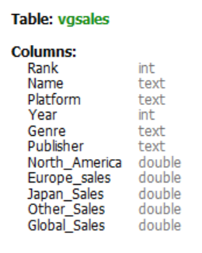
Introduction to Dataset
5
Dataset is taken from : Maven Analytics
The dataset contains a table of video game sales data.
The column names and their data types are mentioned below

Slide 6
Introduction to Dataset
The table consist of 16237 rows and 11 columns
The table contains below attributes
Rank: The position of the video game in the global sales leaderboard, indicating its popularity and sales success.
Name: The title of the video game, used to identify and differentiate it from other games in the database.
Platform: The gaming system (e.g., Wii, NES) on which the video game was released and is playable by users.

Slide 7
Year: The specific calendar year when the video game was first released to the public and became available for purchase. Genre: The category of the video game (e.g., Sports, Racing), defining its gameplay style and thematic content. Publisher: The company responsible for distributing and marketing the video game, ensuring its availability to consumers. North_America: The total sales revenue generated from the video game in the North American market, measured in millions of dollars. European_Sales: The total sales revenue generated from the video game in the European market, measured in millions of dollars.

Slide 8
Japan_Sales: The total sales revenue generated from the video game in the Japanese market, measured in millions of dollars.
Other_Sales: The combined sales revenue from other regions outside North America, Europe, and Japan, measured in millions of dollars.
Global_Sales: The cumulative total of sales revenue from all regions worldwide, providing a comprehensive sales figure in millions.

Slide 9
Analysis of Data

Slide 10
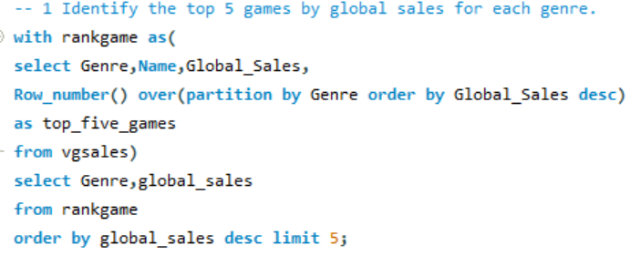
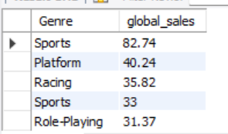
Here are the Top 5 games by Global Sales for Each Genre

Slide 11
Here are the Top 5 games by Global Sales for Each Genre

Slide 12
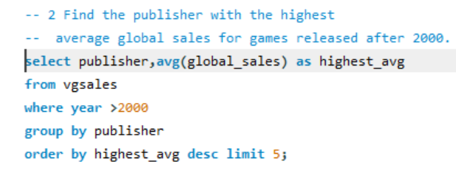
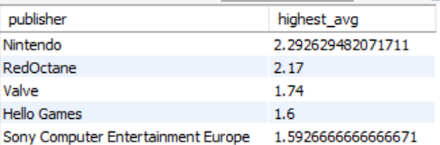
Which publisher has the highest average global sales for games released after 2000?

Slide 14
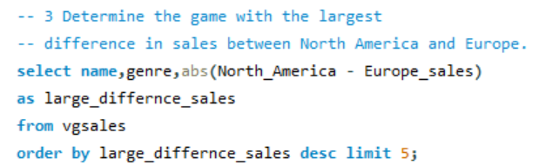
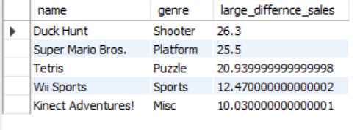
Which game has the largest difference in sales between North America and Europe?

Slide 16
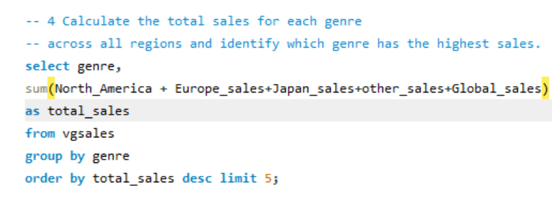
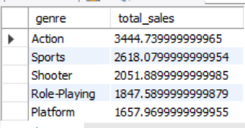
What are the total sales for each genre across all regions, and which genre has the highest sales?

Slide 18
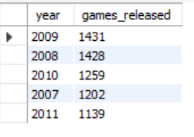

Which year had the highest number of game releases, and what are the top 5 games by global sales from that year?

Slide 20
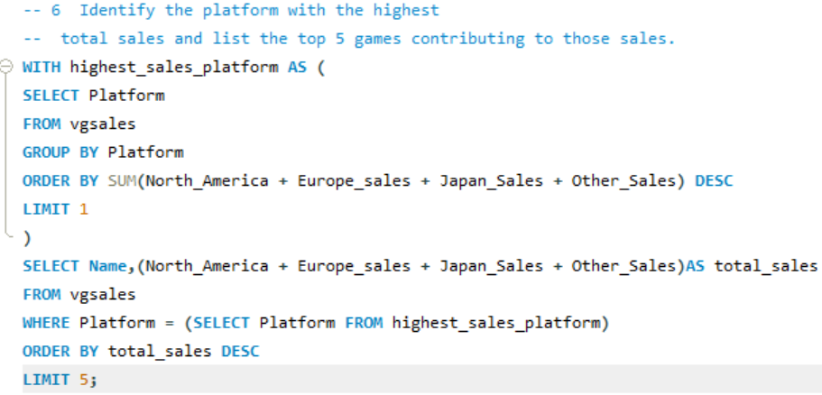
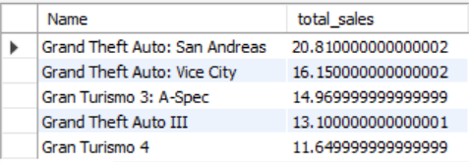
Which platform has the highest total sales, and what are the top 5 games contributing to those sales?

Slide 22
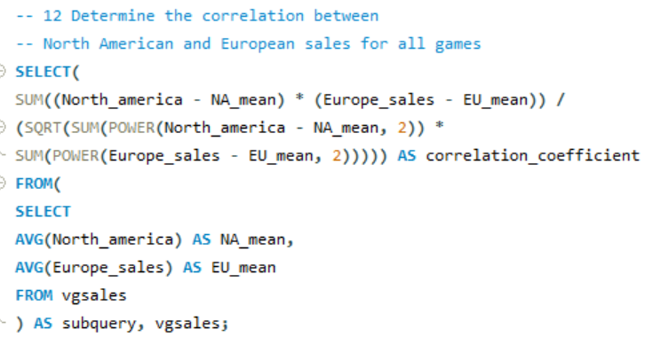
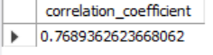
Determine the correlation between North American and European sales for all games

Slide 23
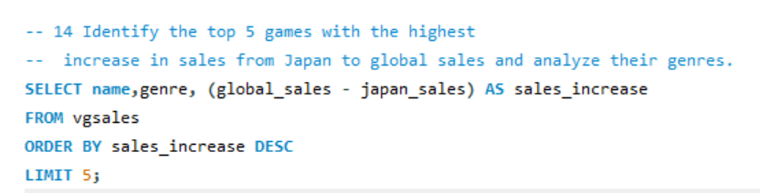
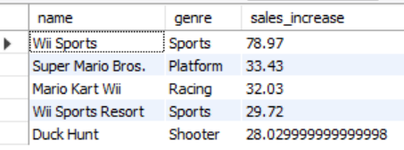
Identify the top 5 games with the highest-- increase in sales from Japan to global sales and analyze their genres.

Slide 25
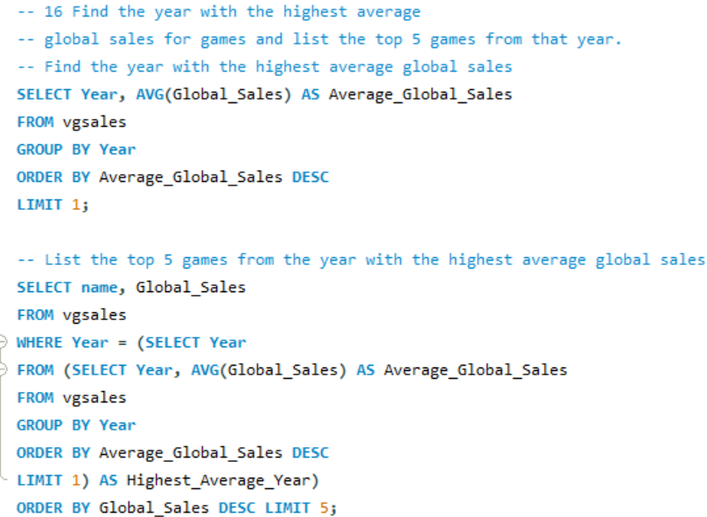
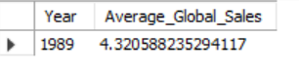
What year had the highest average global sales for games, and what are the top 5 games from that year?

Slide 26
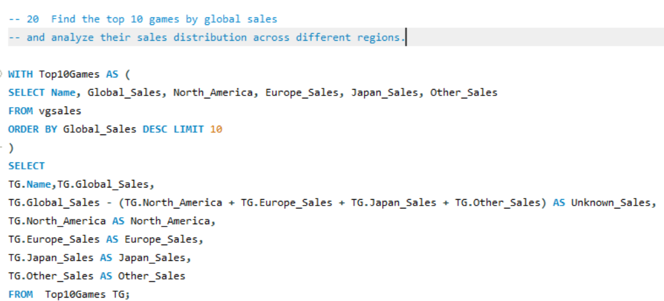
Find the top 10 games by global sales and analyze their sales distribution across different regions.

Slide 27
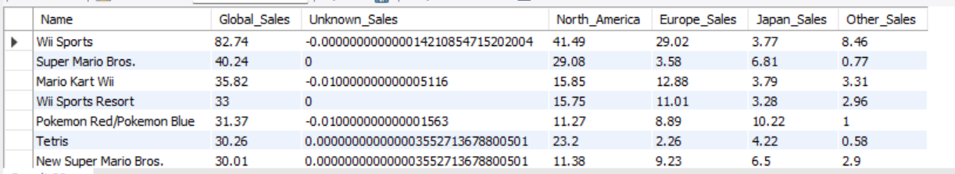

Slide 28
Insights From The above Analysis
Sports, Platform, and Racing genres have the highest-selling games globally.
Top games include "Wii Sports", "Super Mario Bros.", and "Mario Kart Wii“
Nintendo has the highest average global sales for games released after 2000
Nintendo remains a dominant publisher in the 21st century.
"Wii Sports" has the largest sales difference between North America and Europe.
It is significantly more popular in North America compared to Europe.
Some genres, like "Shooter" and "Platform", have higher average sales compared to the overall average.
Nintendo, Electronic Arts, and Activision are among the top publishers by total games released and global sales.
"Pokemon Red/Blue" has the highest sales in Japan.
The Action genre has the highest number of games with global sales over 10 million.

Slide 29
Conclusion
The video game sales data highlights Nintendo's dominance, especially post-2000, with top genres like Sports, Platform, and Racing leading global sales. "Wii Sports" and "Super Mario Bros." are notable high-sellers. The Action genre has the highest overall sales, while 2008 saw peak game releases with hits like "Wii Fit." The Wii platform tops total sales, reflecting its market impact. Strong correlations between North American and European sales indicate similar regional preferences. The data underscores the success of specific genres and publishers, providing valuable insights into market trends and regional popularity within the video game industry.

Slide 30
Thank You

